Slide 1
TOF spectrometer (direct geometry)
Erik Knudsen

Slide 2
Spectroscopy reminder

Slide 3
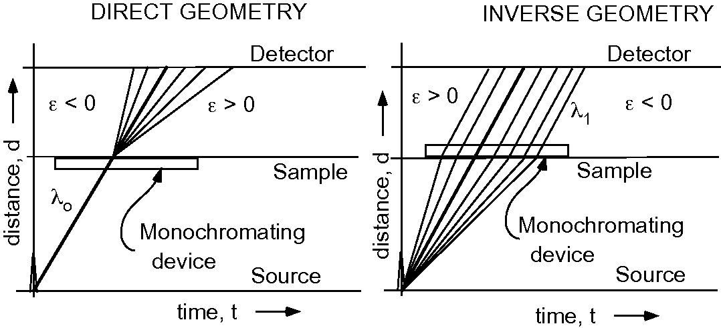
Direct vs. Indirect

Slide 4
Direct vs. Indirect

Slide 5
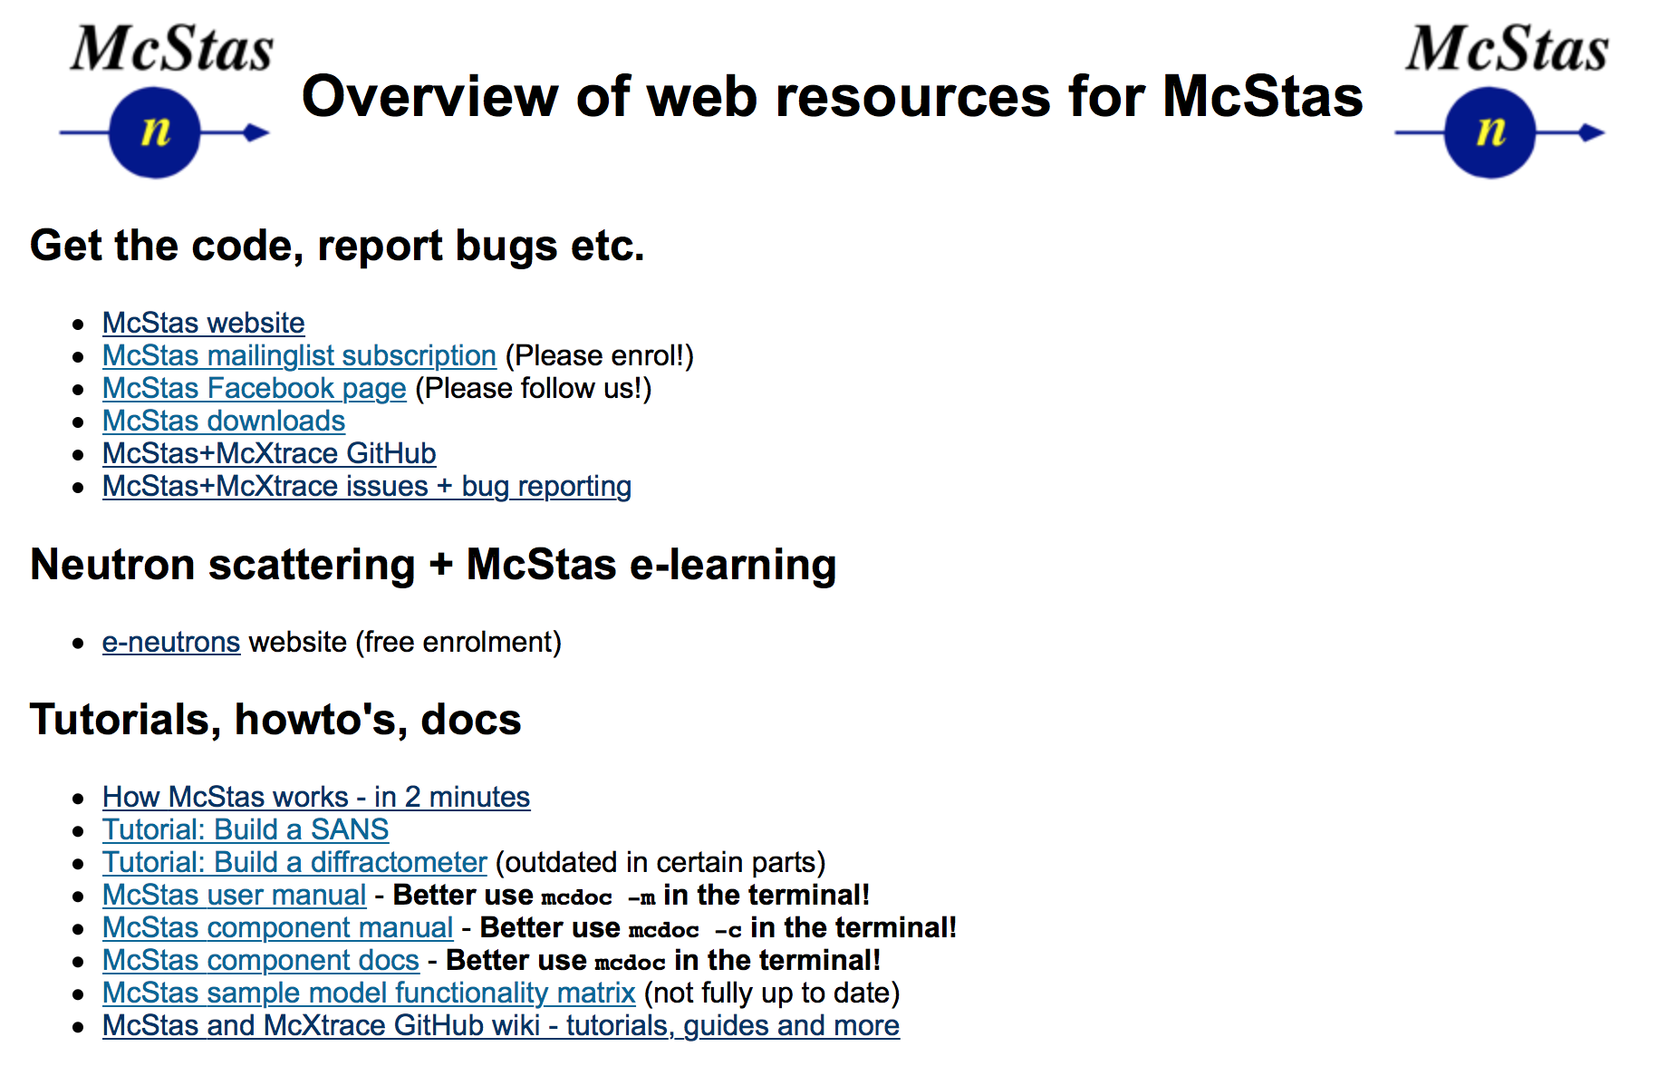
Useful links / docs
http://mcstas.org/links
https://github.com/McStasMcXtrace/McCode/wiki
Documentation on the McCode tools
User documentation for the 2017- Python tool set
mcrun variants - table overview
mcplot variants - table overview
mcdisplay variants - table overview

Slide 6
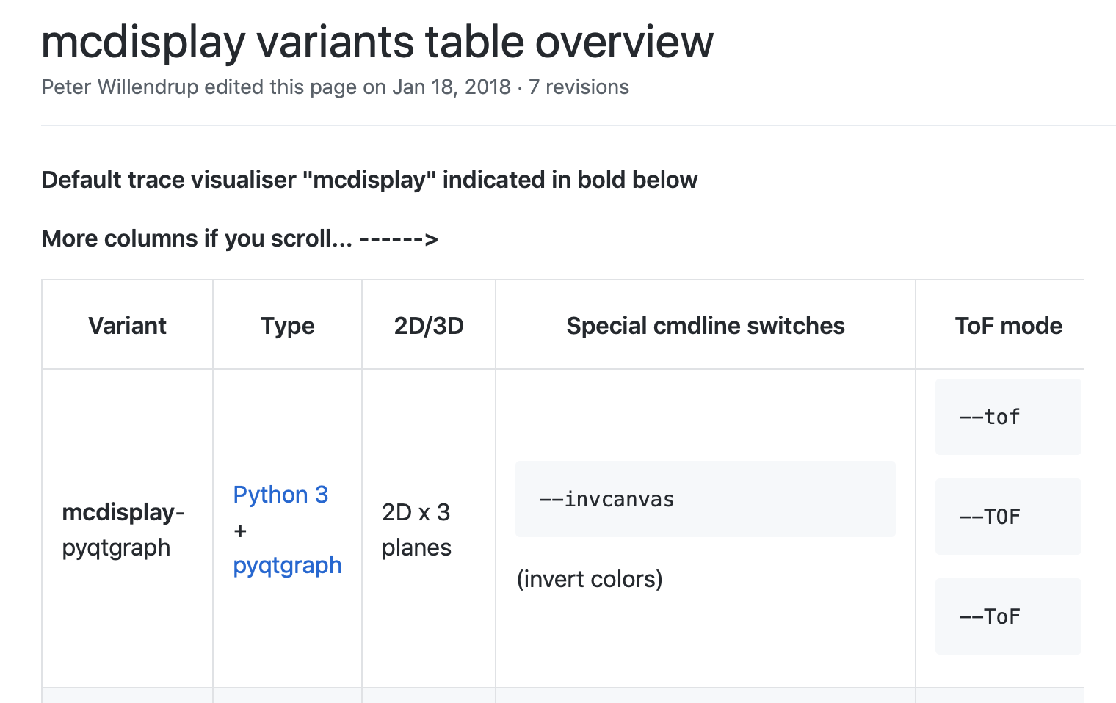
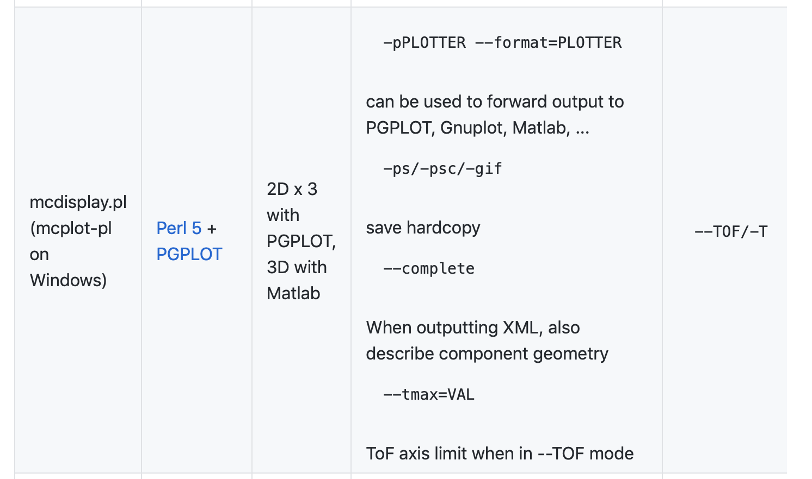

Slide 7
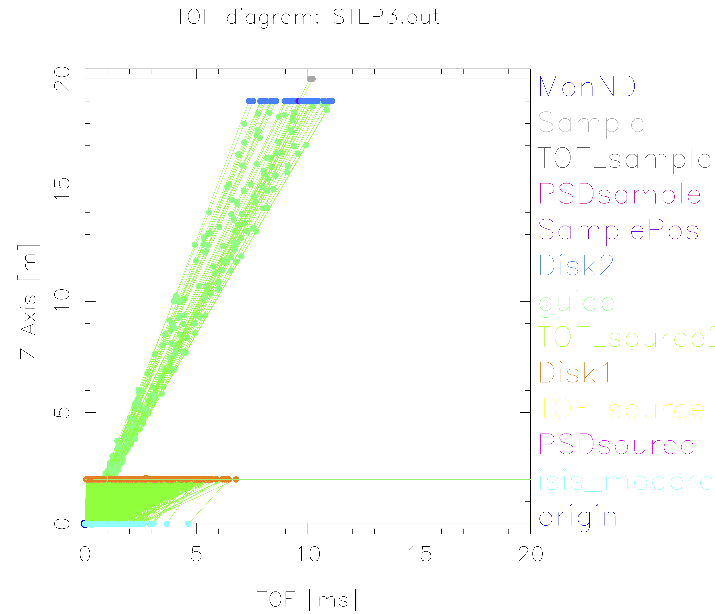
TOF diagram util based on mcdisplay
mcdisplay.pl --TOF --tmax=20 instrument…

Slide 8
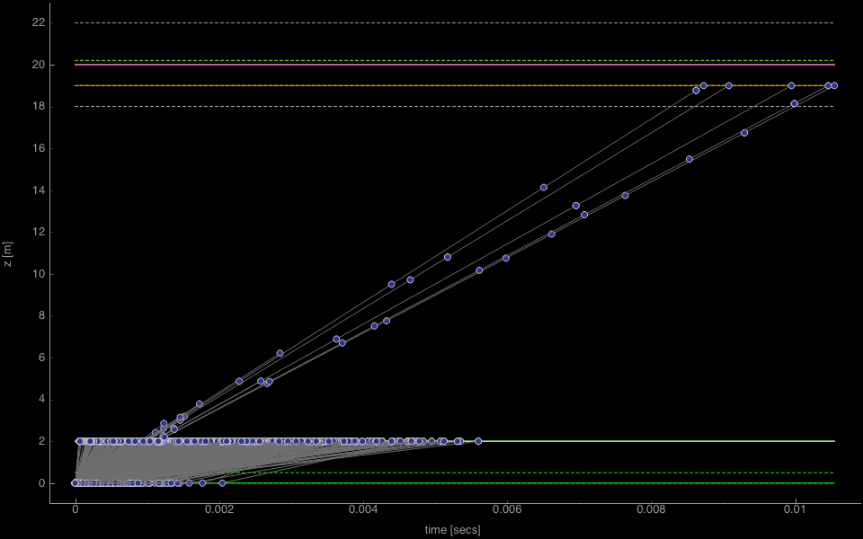
TOF diagram util based on mcdisplay
mcdisplay-pyqtgraph --TOF instr

Slide 9
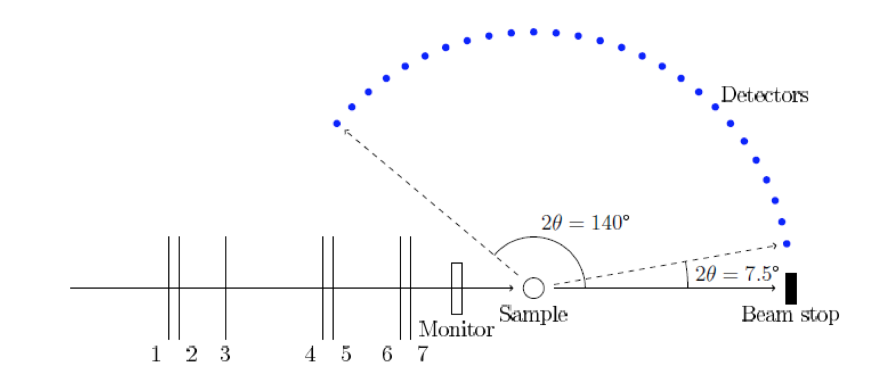
Direct geometry schematic

Slide 10
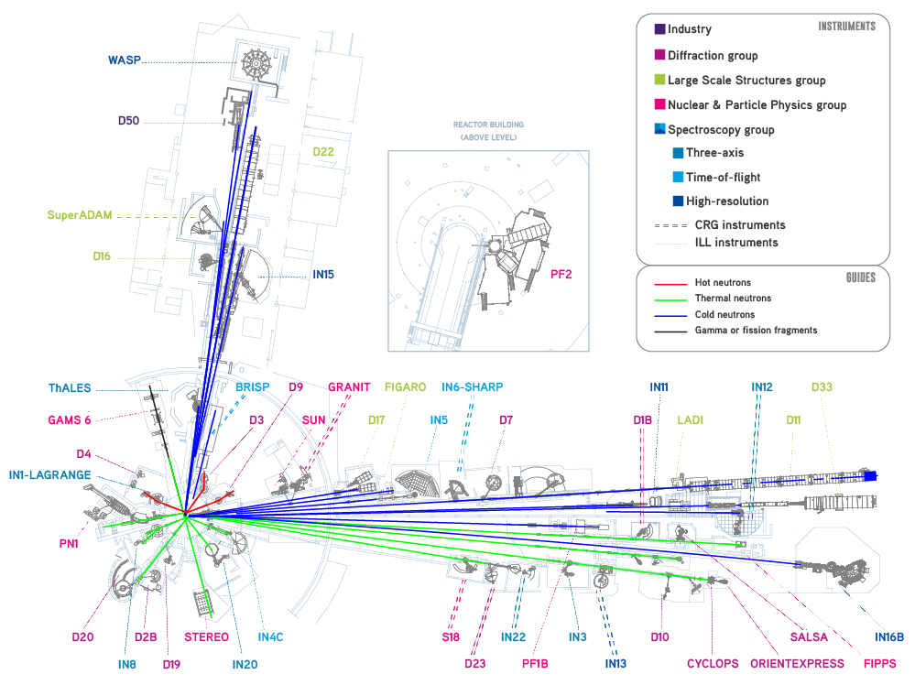

Today’s instruments:
One thermal
One cold

Slide 11
Today’s instruments:
One thermal - IN4
One cold - IN5

Slide 12
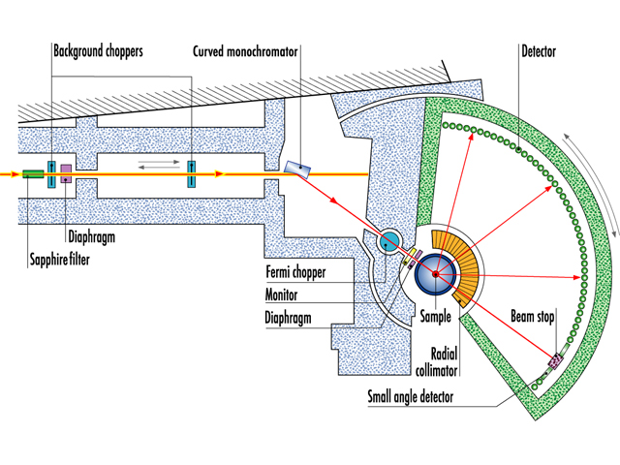
ILL IN4

Slide 13
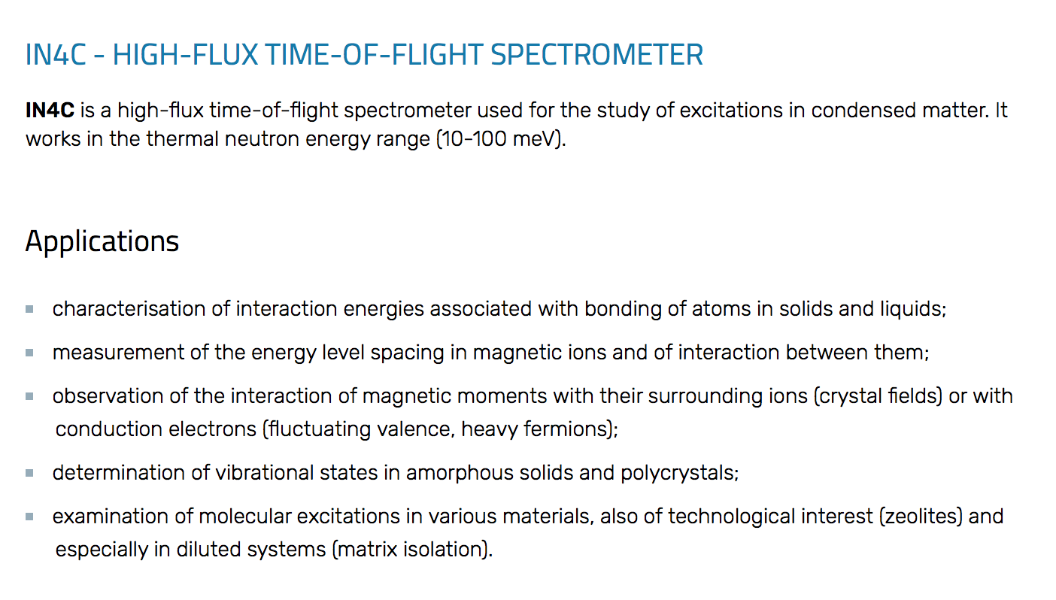
ILL IN4
Thermal, in ILL level C @ reactor face
Use of chopper, focusing monochromator and fermi-chopper

Slide 14
McStas model
Get out ‘Neutron Site -> ILL -> ILL_IN4.instr
Find the documentation for the instrument via Help -> mcdoc Component Reference
Run to compile, and visualise the instrument with mcdisplay-webgl (Use setting in File->Preferences to set mcdisplay tool)
Look at the code in the editor

Slide 15
Special features
In DECLARE/INITIALIZE there is infrastructure to generate an S(q,⍵) with Dirac delta functions which is relevant for the current setting of the instrument
- Accessible by running default parameters, specifically (sample_coh=Dirac2D.sqw. - the default)
Run a simulation with default parameters and 1e7 neutron rays and inspect the output. Locate the detector output that illustrates the instrument resolution

Slide 16
Investigate resolution @ different instrument settings
Run simulations at lambda=1.1, 2.2, 3.3 and 4.4 Å
Hint:
Look at instrument output and documentation, you may have to adjust e.g. monochromator type for non-default wavelength
Comment on the found differences
Optionally play with monochromator mosaicity

Slide 17
ILL IN5

Slide 18
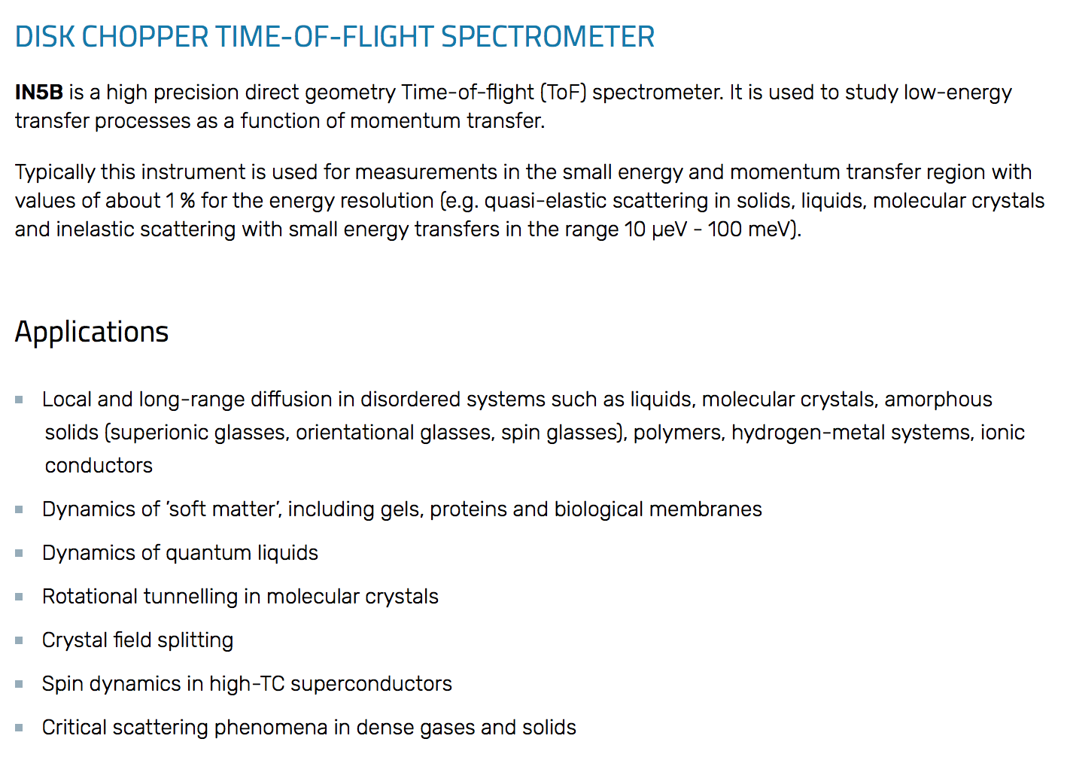
ILL IN5
Cold, in ILL7 guide hall
- On a guide with a 6-diskchopper setup

Slide 19
ILL IN5 resolution
Use the ILL_IN5_Spots.instr from your local McStas
Run the instrument as is, observing diffraction from powder lines
Also visualise the instrument using mcdisplay

Slide 20
Enclosed modifications wrt. IN5 in McStas
Resolution mode ala IN4 simulation, accessible by input parameter RESO=1
Single-peak inelastic Dirac peak accessible by input parameters:
ttspot (where to point the peak in angle)
nspots (how many spots to define)
wspot (magnitude of energy exchange)

Slide 21
Perform studies of resolution, IN5
- Use your gathered experience from the earlier IN4 simulations
Comment on the qualitative difference to the resolution function from IN4

Slide 22
Investigate resolution properties via Spot_sample
Run a simulation with
nspots=1 (one discrete inelastic spot)
wspot=1 (energy-transfer 1meV)
ttspot=-60,60 (vary spot position qvalue)
-N13 (13 scan steps)
Investigate influence of sample size (reduce height and radius parameters)

Slide 23
Investigate resolution properties via Spot_sample
Inelastic: Run a simulation with
nspots=1 (one discrete inelastic spot)
wspot=1,4 (energy-transfer 1meV to 4meV)
ttspot=0 (vary spot position qvalue)
-N21 (21 scan steps)

